Slide 1
User Stories and UML
Use Case Diagrams
By PJ Davies
With Reference to:
  Real-Time UML by BP Douglass.
  ISBN 0-201-65784-8
Use-Case Diagram Tutorial based on Visual Paradigm (tool we will use): https://www.youtube.com/watch?v=tLJXJLfLCCM&list=PL05DE2D2EDDEA8D68
Use-Case Diagram overview
https://www.youtube.com/watch?v=zid-MVo7M-E
©Paul Davies 2020. Not to be copied, used, or revised without explicit written permission from the copyright owner. This lecture may contain animations and is best viewed as a slide show

Slide 2
Use Case Analysis
In the last lecture we looked at agile development and the important role analysis plays as a starting point for gathering requirements and building a model of the software before it is handed over to developers.
In this lecture, we are going to introduce UML’s Use Case Diagrams as a graphical/textual tool to capture those requirements in one central place.
You can think of a use-case diagram as a more “formal” version of agile “user story”, one with much more detail, in other words we might start off with a user story to capture the basic “needs” of the customer and then expand that 2 or 3 sentence description into a more detailed “use-case” description capturing
  What Data goes in and out of the system.
  Constraints (i.e. what is permissible/required or not).
  Actions/Interactions between user and system, possibly including any if-else and do-while decisions.
  The Benefit to the user (i.e. what they get out of the interaction.
  What the Effect of that interaction is on the system (i.e. what changes).

Slide 3
Example Use Case Analysis: A Library
Consider the proposal for automating an antiquated library where books, membership and loan details are currently stored on a paper based card indexing system maintained by a librarian.
One user story might be:-
“As a member of a library, I want to be able to borrow books
so that I can enjoy reading them without buying a copy”
How do we turn that into a set of interactions we could implement on a computer?
One of the most powerful methods is to concentrate on the user interactions that will take place within the system. These can be uncovered by interviewing a domain expert – someone who is doing the job now, or knows what needs to be done.
A good example of a domain expert is a librarian. He or she understands the rules and regulations governing how the library currently does business.
Ask the librarian to describe the process of how a member borrows a book. Focus on
  What information is needed?
  How is the borrowing recorded?
  What special rules apply?

Slide 4
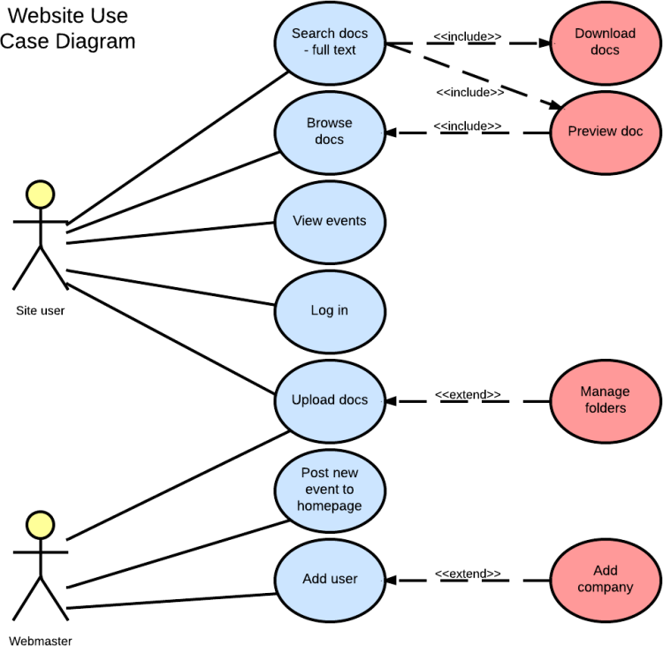
Where does UML fit in with Agile?
If the stories are simple and the time line is short, it’s possible to go directly from “User Story” to coding with only a minimum of discussion and documentation.
When it’s complex we could expand the “User Stories” into a more formal “UML Use case Model” at the start of each sprint. (see example below)
https://www.youtube.com/watch?v=Vnf3xg3oY4A
Example Use-case diagram. Not of a library, but just for illustration purposes.
Use case diagrams capture users and their requirements (needs)

Slide 5

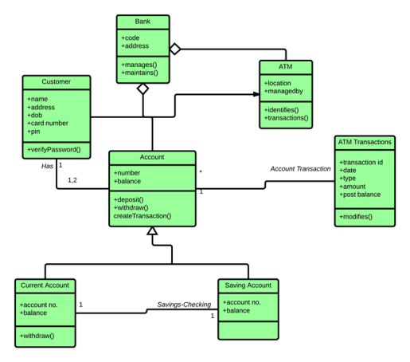
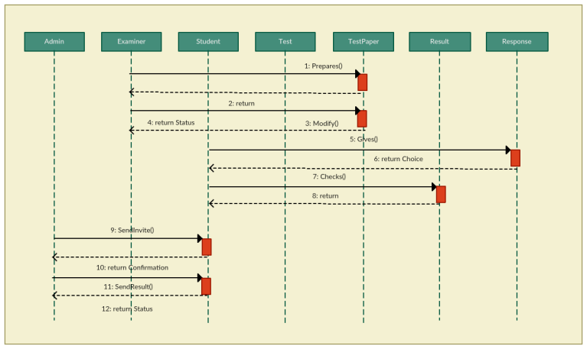
From there we can focus on a subset of use cases for inclusion in the next release.
Again for simple system, we might go directly to code, but for complex systems, that take dozens of developers months or years to build, it might require that we develop models of the architecture and behaviour of our system using UML Class and Sequence diagrams (see later lectures).
Story 1
Develop Use Case Diagram
Expand User Stories into Use Cases and add to a UML Use-Case Diagram
Story 2
Story 3
Capture behaviour interaction using sequence diagram, 1 per use case
Develop /update Architecture and UML
Class Diagram for use-cases in this sprint

Slide 6

Example: Capturing Requirements for a Computerised Library System

Slide 7
Library Use Cases
UML use cases are more formal descriptions of agile’s user-stories. They evolve directly from stories but flesh out the details and help break the stories into “bite sized steps” for discussion and implementation. They describe the sequence of interactions played out between a user and the system as it attempts to realise that user story i.e. how it is going to play out when it has been implemented in software. Some example use cases for a library are listed below.
  Checking out a book for loan.
  Checking in a returned book.
  Checking if a book is in stock and where to find it.
  Reserving a book that is currently out on loan.
  Dealing with payment of overdue fines.
  Adding new members to the library.
  Deleting old members from the library.
  Dealing with changes of members details e.g. name address etc.
Interviewing a domain expert such as the librarian is crucial to helping us understand how the system works now and what it might become once it has been computerised.
Example Library Use Cases

Slide 8
Library Use Cases (cont…)
In a large library it is reasonable to assume there might also be a head librarian (a more specialised librarian) who represents another kind of a domain expert
For example, a head librarian might be able to do the following (as well as all the work of a junior librarian).
  Add new copies of a book to the library.
  Delete old copies of a book from the library.
  Issue ‘Book Overdue’ letters and fines.
Each of the above bulleted points represents a UML ‘Use-Case’.

Slide 9
What is a Use-Case?
Definition
A process or procedure, describing in detail a user’s interaction with the system (e.g. a library) for a specified, identifiable purpose. (e.g. borrowing book).
As such, each and every Use-Case describes a step-by-step sequence of operations, iterations and events that capture
  Who the User is
  The Interaction taking place (data going in/out and from whom).
  The Measurable Benefit to the user interacting with the system.
  The Effect of that Interaction on the system i.e. what has changed inside the system as a result of the interaction/use-case.
It is important to document these use-cases as fully as possible, as each use-case captures some important functionality that our system must provide to satisfy its customers/users.
(Check this out once we have finished https://www.wikihow.com/Write-a-Use-Case )

Slide 10
Use-Case description for “Borrowing a Book” – A first preliminary attempt
The member identifies him/her self to the librarian and indicates which books they wish to borrow.
If it is acceptable for them to borrow these books, i.e. they are not marked “for reference only”, or the number of books on loan to the customer is less than some predetermined maximum, then the books are loaned to the customer for a specified loan period.
The member’s loan record is updated to reflect the loaned books.
The library’s loan record is updated to show the member has borrowed the books.
Class Question: What is the effect on the system of these interactions and the benefit to the user?
Once the above has been documented, we could attempt to ‘flesh-out’ the details by re-interviewing all interested parties, and expand our understanding of these objectives in more detail perhaps including the libraries business rules and information about the nature of the data being processed.

Slide 11
User Stories
Develop a UML Use Case Model
Document and Design
Document Preliminary Use Case Descriptions
General Statement of objective
Story 1
Story 2
Story 3
See next slide
Story 4
Develop more detailed descriptions, e.g. capture interesting scenarios (if-else or pseudocode), important business rules etc.
More detailed description, e.g. capture interesting scenarios (if-else or pseudocode), important business rules etc.
Story 5
UML
Model
Story 6
Story 7
Create a model and capture on Class Diagrams, Sequence Diagrams etc.

Slide 12
Use-Case description for “Borrowing a Book” – A 2nd more detailed attempt
  Use-Case: Borrow Book
  The borrower/member identifies himself or herself to the librarian using some kind of membership identification card.
  The borrower/member presents one or more books to the Librarian.
  The Librarian checks the books to make sure they can be loaned.
  The Librarian checks the membership card to make sure it is valid.
  The Librarian looks up the member’s records in his/her card indexing system and checks that the number of loaned books will be less than 6
  (the maximum that can be loaned at any time to a library member).
  The Librarian refuses to loan books to members with overdue fines.
  If acceptable, each book is stamped with the appropriate return date
  (2 weeks from today).
  Each book has its identifying card removed from the inside cover.
  The Librarian updates the member’s loan details by placing the identifying cards from the books into that members loan record.

Slide 13
Homework Exercise:
See if you can describe objectives and detailed use-case descriptions for the other use cases associated with the library system. In particular identify
  Who are the users that initiate the interaction.
  What interaction takes place.
  What are the benefits to the user from that interaction.
  What is the effect on the system.
Reading the previous slides about a set of library requirements, you may be wondering why we need to bother with all this use-case analysis – surely it’s all just kind of obvious isn’t it? Well yes and no. It’s obvious for a library, because we all know how they work – automated libraries already exist, we’ve used one before.
But what if you were writing S/W for a system that does not exist yet. You have no insight into how it should work and it wouldn’t be obvious. How do you think Amazon came up with their software, what about Twitter, Zoom, TikTok, Instagram.
At some point these were all new S/W systems and nothing was known about them. They were blank sheets of paper and there is no harder place to start from than that. That’s where requirements analysis and user stories/use case descriptions are essential to uncovering functionality.

Slide 14
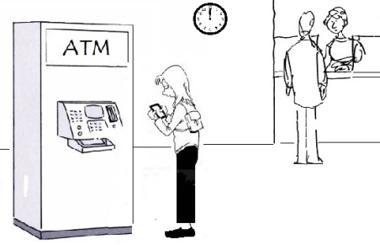
Another Example. A Cash Dispenser/ATM.

Slide 15
Example 2. A Cash Dispenser/ATM.
Let’s attempt to identify use case for a cash dispenser or ATM.
Again this is probably something you already understand (you’ve used one) and thus you are already domain experts, so why use something we already know? So you can readily understand how to apply UML without also having to wrestle with understanding the problem.
In essence, this system (a completely new automated system, as opposed to a manual one, i.e. a system that did not exist before) provides the following functionality captured in use cases from user-stories,
  Withdraw Cash
  Request Balance
  Request Statement
  Request Cheque book
Example User Story: As the owner of a bank account, I want to be able to withdraw money from my account so that…….
Let’s take the ‘Withdraw Cash’ use-case and identify the interaction that takes place between a user (a person with an ID card wishing to borrow money) and the system (the cash dispenser/ATM).

Slide 16
Use-Case - “Withdraw Cash” – A first attempt
  The user identifies him/her self to the system and requests a withdrawal for an amount of cash.
  A check is made, to make sure their account would remain in credit after the withdrawal. If so, they are dispensed the cash and their account is debited accordingly.
Classroom Question: Is this enough info to be considered an initial Use case? Does it
  Capture an identifiable user of the system?
  Capture the benefit to the user?
  Capture the effect on the system as a result of the interaction?

Slide 17
Use-Case “Withdraw Cash” – A More detailed description
  Use Case Withdraw Cash
  The user inserts their ID card into the system.
  The system reads the magnetic strip from the card to identify user & account.
  The system prompts the user to enter their PIN.
  The user enters their PIN.
  The system contacts the banks central computer to verify the PIN number for the card and their account details.
  If PIN is authenticated the user is prompted for the amount of the withdrawal. If not, the card is returned to the user with an appropriate failed message.
  The system prompts for the amount of the cash withdrawal.
  The user enters the amount of the cash withdrawal.
  The system checks with the banks central computer to ensure that the user has sufficient funds to make the cash withdrawal.
  If there are sufficient funds, the cash is dispensed and the customer’s account at the Bank Central Computer is debited accordingly, otherwise an appropriate “insufficient funds” message is displayed
  The card is returned to the user and a receipt is printed.
Questions: How much detail should we include in a use-case? What about descriptions of data, e.g. PIN, Magnetic Strip, Account Details etc, what are these – what is their format? Is it important to document these? YES absolutely as the developer will only ask for it later if you don’t.
Exercise: See if you can describe in detail the other use cases for an ATM.

Slide 18
What are we trying to capture in use cases?
Some people get hung up on how exactly they should write use-cases. There are no hard and fast rules about what is right and wrong, there is no precise syntax, that needs to pass through the eyes of a compiler. Use cases, are only read by other people (developers and clients). Like telling a story, different people tell it in different ways, they emphasise different things and from different perspectives.
Remember – if some feature/interaction isn’t captured in a use-case, its unlikely to ever end up in the shipped product, so time spent at the beginning (during analysis) will pay dividends later during design/code/test. Revisit this phase as often as necessary to get a complete picture.
The important thing is that it captures the interactions that you expect will be played out on the system, the benefit to the user and the effect on the system. If you haven’t got these 3 things – it’s incomplete.
IMPORTANT: Use case descriptions should focus on “what” needs to be achieved, what interaction takes place rather than “how” that interaction will be implemented. e.g. identifying a user is something that occurs in both a library and an ATM, but the mechanism to achieve it is different even between the manual library and the automated one, so emphasise the “need to identify user” in your use case and leave the “how to do it” until later when alternatives could be discussed.

Slide 19
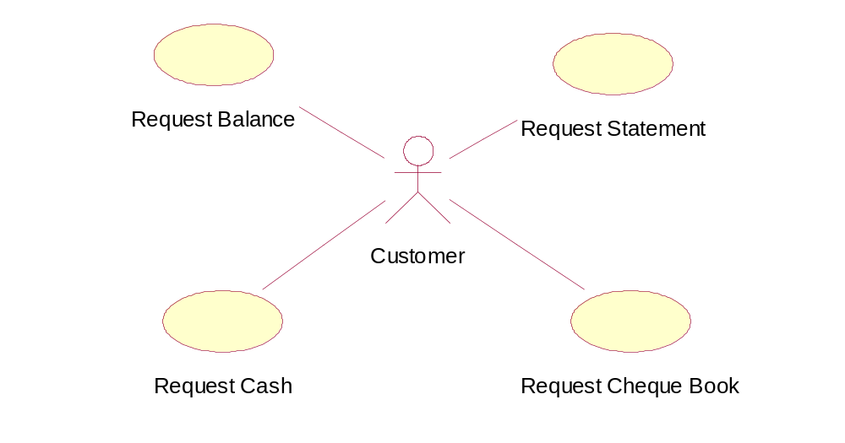
Capturing Use-Cases: The Use Case Diagram
Use cases are captured in UML on a ‘Use-Case Diagram’, as shown below.
You will notice that it is a very simple diagram, involving just two types of symbols, a stick figure referred to as an ‘actor’, and a named oval representing each of the identified use-cases. Each oval is documented with a detailed description
Withdraw Cash
ATM Use-Case Diagram

Slide 20
What is an Actor?
An actor represents an external entity outside of the system we are modelling. Most commonly these are the users of the system who initiate one or more use-cases and are typically people, but could in fact be other hardware.
An Actor is somebody/something that initiates an interaction with the system and gets some measurable benefit from that interaction.
Request Balance
Request Statement
Withdraw Cash
Request Cheque Book

Slide 21
What does the Oval represent?
The oval represents a unique use-case which attempts to capture high level requirements or functionality that our system must provide to its users.
As such, all use-cases must be initiated by Actors.
Withdraw Cash

Slide 22
Each use-case is documented somewhere with a detailed description of the interaction between user and system and the benefits to the user.
UML tools allow you to document each use case directly.
Alternatively you could just use a text editor to record it.
  Use Case Request Balance
  …
  …
  …
  …
  …
  …
  End
  Use Case Withdraw Balance
  …
  …
  …
  …
  …
  …
  End
  Use Case Request Statement
  …
  …
  …
  …
  …
  …
  End
  Use Case Withdraw Balance
  …
  …
  …
  …
  …
  …
  End
  Use Case Withdraw cash
  The user inserts their ID card into the system.
  The system reads the magnetic strip from the card to identify user & account.
  The system prompts the user to enter their PIN.
  The user enters their PIN.
  The system contacts the banks central computer to verify the PIN number for the card and their account details.
  If PIN is authenticated the user is prompted for the amount of the withdrawal. If not, the card is returned to the user with an appropriate failed identification message.
  The system prompts for the amount of the cash withdrawal.
  The user enters the amount of the cash withdrawal.
  The system checks with the banks central computer to ensure that the user has sufficient funds to make the cash withdrawal.
  If there are sufficient funds, the cash is dispensed and the customer’s account at the Bank Central Computer is debited accordingly, otherwise an appropriate “insufficient funds” message is displayed
  The card is returned to the user and a receipt is printed.
  End
  Use Case Withdraw cash
  The user inserts their ID card into the system.
  The system reads the magnetic strip from the card to identify user & account.
  The system prompts the user to enter their PIN.
  The user enters their PIN.
  The system contacts the banks central computer to verify the PIN number for the card and their account details.
  If PIN is authenticated the user is prompted for the amount of the withdrawal. If not, the card is returned to the user with an appropriate failed identification message.
  The system prompts for the amount of the cash withdrawal.
  The user enters the amount of the cash withdrawal.
  The system checks with the banks central computer to ensure that the user has sufficient funds to make the cash withdrawal.
  If there are sufficient funds, the cash is dispensed and the customer’s account at the Bank Central Computer is debited accordingly, otherwise an appropriate “insufficient funds” message is displayed
  The card is returned to the user and a receipt is printed.
  End
  Use Case Cheque Book
  …
  …
  …
  …
  …
  …
  End
  Use Case Withdraw Balance
  …
  …
  …
  …
  …
  …
  End
Withdraw Cash
ATM Use-Case Diagram with text descriptions

Slide 23
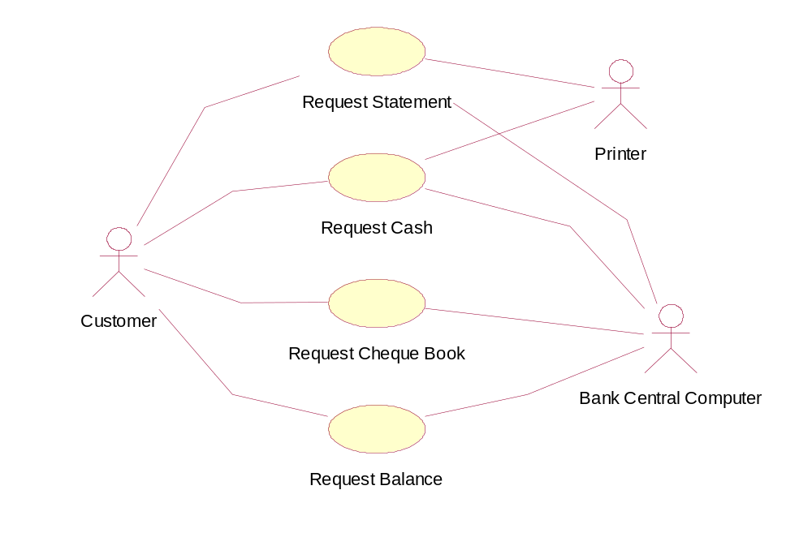
Could we show the Bank Computer and Printer as Actors?
Possibly, they are external entities that are involved, but because they do not initiate a use-case, the UML refers to them as “secondary” actors, a bit like a librarian in an automated library system, he or she is involved when a library member (the primary actor) borrows a book, but does not initiate the borrowing.
Withdraw Cash
Primary User
Secondary Users

Slide 24
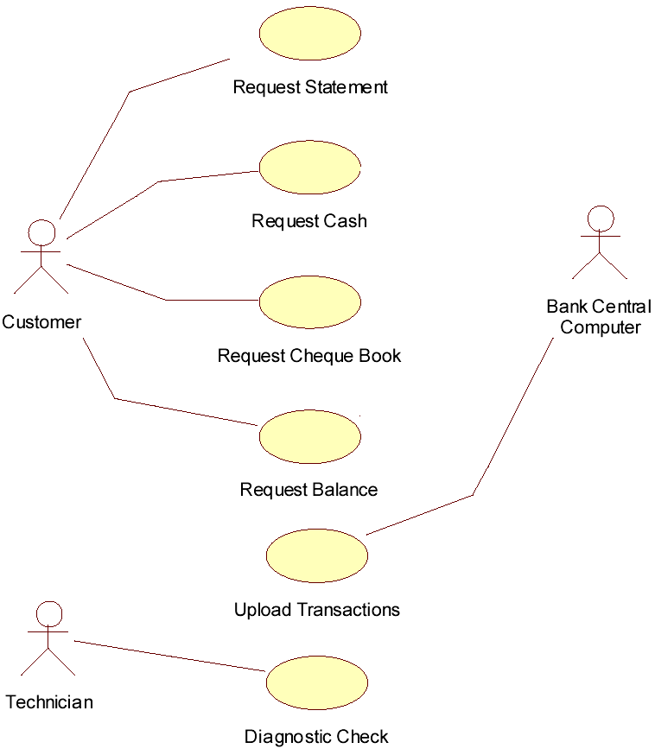
What if a computer did initiate a use-case?
E.g.: Suppose another use-case exists which allows a bank central computer to request that the ATM upload details of all the transactions that had taken place that day. How would we show that?
A: Show the computer as a user and add the upload transaction use case
Another Example
Q: Suppose a new use case is created allowing a Technician, to run a ‘Diagnostic Check’. How would we show that?
A: Show the Technician as a user and add the Diagnostic Check use case.
Withdraw Cash

Slide 25
A Use case diagram looks so simple, why bother with it?
Firstly it shows the BIG-PICTURE without getting bogged down in the details of design and implementation (i.e. It’s pretty much independent of hardware, OS, GUI, programming language, databases, networks etc) so it focuses on what needs to be done, not on how it will be done.
Secondly, it’s easy for a customer to relate to (and the text descriptions for each use case) and identify the major objectives of their business within it.
This means that any missed or misunderstood functionality required from the system is less likely to be overlooked during analysis (very important).
From a developers point of view they can immediately assess the functionality required and assess the risk involved in implementing each use case.
A use case diagram and description takes us one step closer to being able to code a solution.
Cont…

Slide 26
The software development manager can also begin to plan delivery schedules, estimate costs, hire new developers, buy the tools and plan the training needed to successfully deliver the product.
Because modern software development follows an iterative approach, each new release of the software can be based around the implementation of one or more use-cases.
Thus it is easy to identify what functionality is required with each new release.
It fact the customer should be actively involved in the planning and release process by prioritising the use cases for each release in terms of must-haves and nice-to-haves, thus they get to chose the functionality of each new release.

